Slide 1
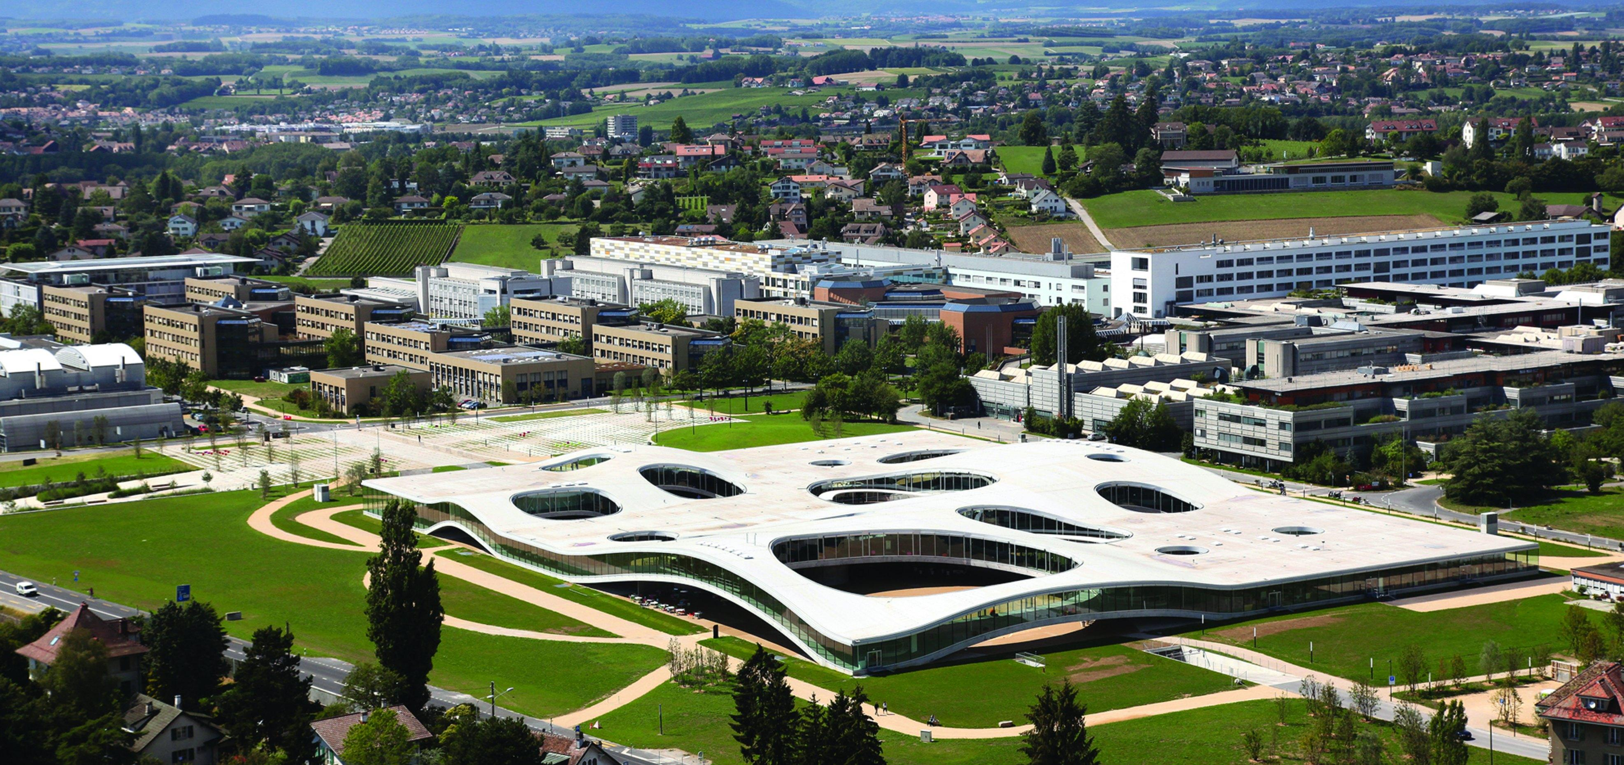

Action Recognition for Self-Driving Cars
Semester Project (15 ECTS)
Student: Weijiang Xiong (Microengineering)
Supervisor: Prof. Alexandre Alahi, Lorenzo Bertoni, Dr. Taylor Mordan
Date: Jan. 12 2022
Notes:
Hello everyone, I’m Weijiang Xiong, and today I’m very happy to share my project with you.
This semester I’m working on Action recognition for self-driving cars with Lorenzo and Taylor.

Slide 2
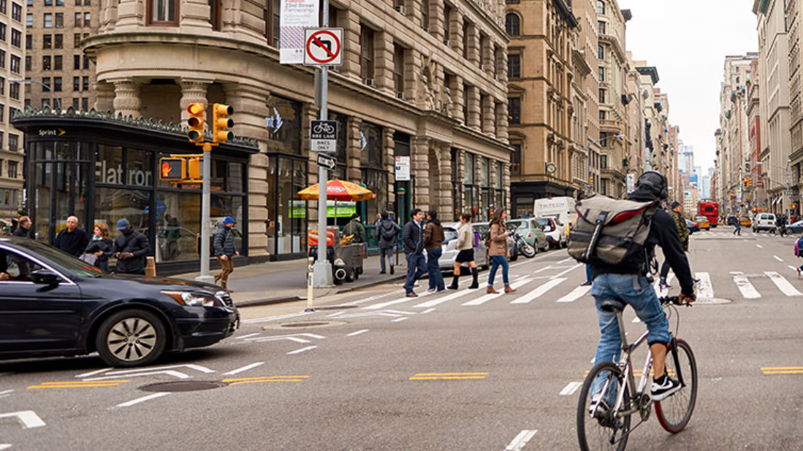
Image taken from https://usa.honda-ri.com/titan
Notes:
Action recognition means Identifying people’s actions in a video or image sequence
in this image, we can easily tell that this man is cycling, these people are walking.

Slide 3
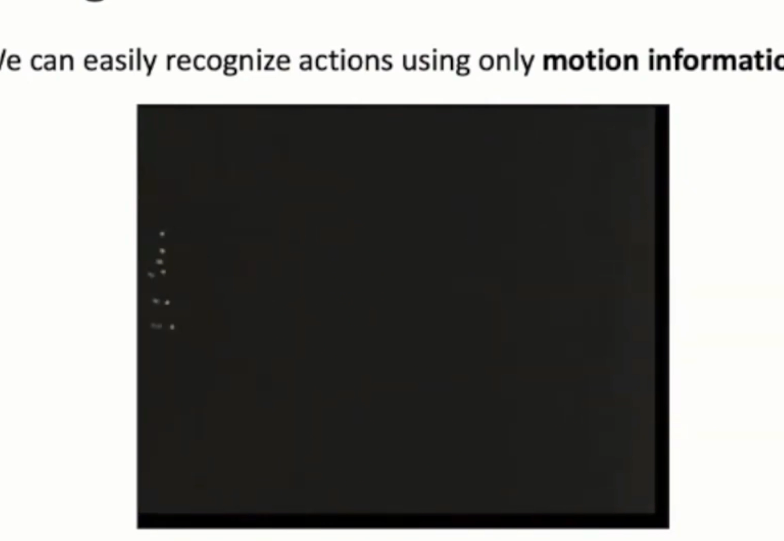
Introduction and Motivation
Action Recognition
Identify people’s actions in a video/image sequence
For self-driving cars: understand the environment, make safe decisions and plan reasonable paths
Problem Description
Input: a video or a sequence of images
Output: the type of actions for every person inside
Motivation for Pose-Based Methods
Human poses are light-weight but highly informative
Successful work on pose estimation and pose-based vision (related work)
Video Source: Justin Johnson. Umich. Deep Learning for Computer Vision. Lecture 18. 2019 Fall
Notes:
Action recognition is important for decision making of self-driving cars
and precisely, we take a video or a sequence of images, then predict people’s actions
In my project, I work with pose based methods
Because poses are light-weight but highly informative, and we can easily recognize what these people are doing, even if we just see a few points
Besides, there has been successful work on pose based vision

Slide 4
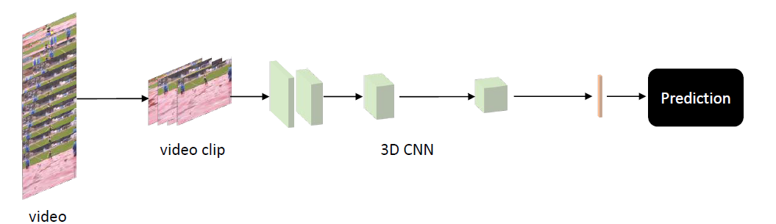
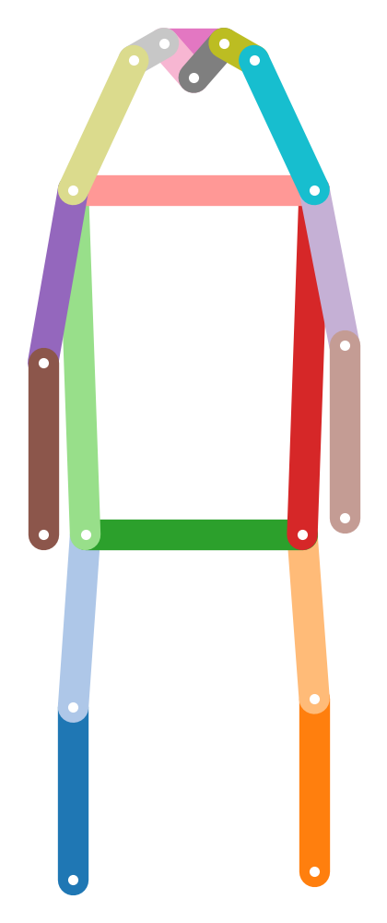
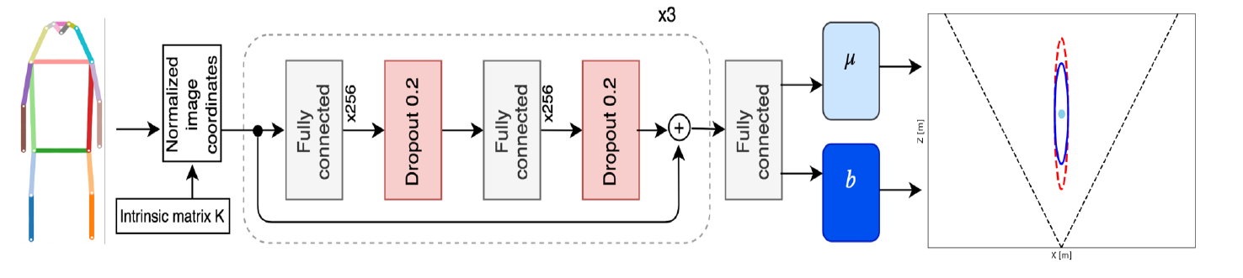
Related Work
Inflated 3D Convolution (I3D [1]) for video action recognition
computationally expensive
OpenPifPaf [2] and MonoLoco [3]
location
poses from OpenPifpaf
uncertainty
[1] Joao Carreira and Andrew Zisserman. Quo Vadis, Action Recognition? A New Model and the Kinetics Dataset. CVPR 2017
[2] Sven Kreiss et al., OpenPifPaf: Composite Fields for Semantic Keypoint Detection and Spatio-Temporal Association. IEEE T-ITS 2021
[3] Lorenzo Bertoni et al., Monoloco: Monocular 3d pedestrian localization and uncertainty estimation. ICCV2019
Notes:
In literature, people usually use 3D CNNs for action recognition, but they are computationally expensive
Meanwhile, Monoloco takes 2D human poses from pifpaf, and predict the 3D location and uncertainty of the persons
Inspired by this, I will use a similar architecture and modify the network according to the datasets

Slide 5
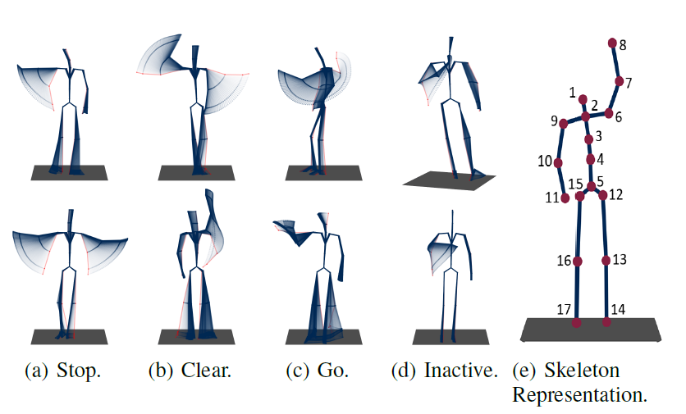
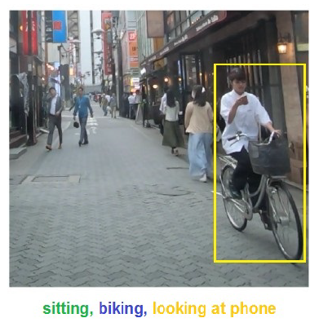
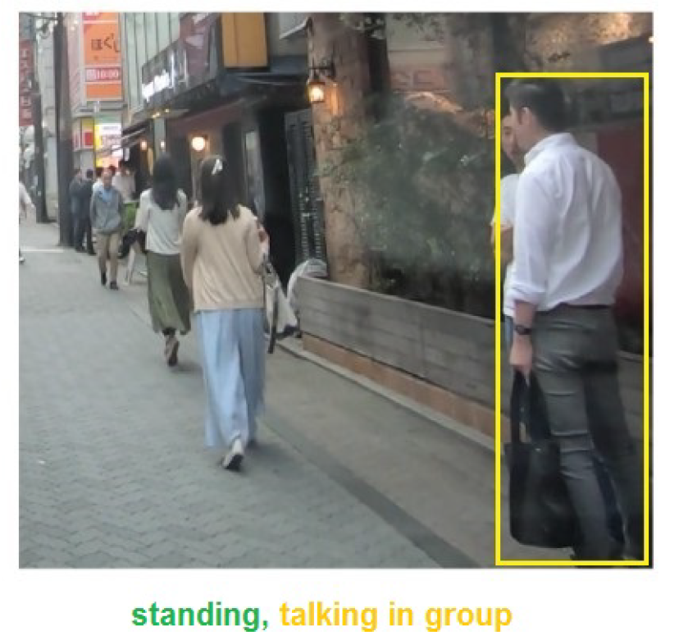
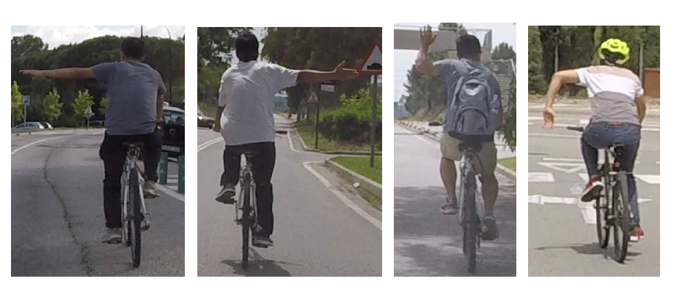
Datasets and Evaluation
TCG [4]: 3D body poses for Traffic Control Gesture
550 sequences from different actors (cross-subject evaluation) observed from multiple view points (cross-view)
TITAN [5]: 700 video clips captured with onboard camera
Annotations include five groups of actions, from individual actions (e.g., standing) to those involving context (e.g., talking in group)
CASR [6]: Cyclist Arm Signal Recognition
178 collected videos, 8 additional videos from youtube (for testing only)
Extract poses for TITAN and CASR with OpenPifPaf
[4] Wiederer et al., Traffic Control Gesture Recognition for Autonomous Vehicles. IROS 2020 [5] Malla Srikanth et al., Titan: Future forecast using action priors. CVPR 2020
[6] Fang et al., Intention Recognition of Pedestrians and Cyclists by 2D Pose Estimation. arXiv:1910.03858
Left, Right, Alternative Right, Stop
Notes:
So let’s look at the three datasets first,
TCG contains 3d body poses for traffic control gesture, and it has cross-subject and cross-view evaluation protocols to cover variations in actors and view points
The titan dataset has video clips from an onboard camera, and people’s actions are organized into five groups, from individual actions to those involving the context
CASR dataset contains video sequences for cyclist arm signal, with additional test videos from youtube

Slide 6


Poseact: Action Recognition with Human Poses
Base Network
$$× N$$
Linear Layer
Dropout
Linear Layer
Dropout
Embedded Features
Prediction head
Prediction heads
Model Name | Poseact | TempPoseact
Prediction head
Temporal Info | No | Yes
Linear 1
Linear K
Linear 1
Linear K
K=1 for TCG and CASR (usual case)
K=5 (Multitask) for five action groups in TITAN
$$⋯$$
$$⋯$$
LSTM
Notes:
Our model is called poseact
the base network remains the same as MonoLoco, we embed the keypoints with linear layers and then put the features to a prediction head.
As a general notation, the prediction head of poseact consists of multiple linear layers, one layer for one action group.
and the temporal model has an LSTM to process the features over time

Slide 7
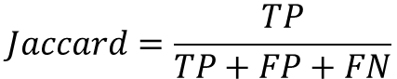
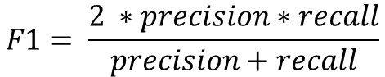
Action Recognition Results on TCG
Method | Cross-subject (%) |  |  | Cross-view (%)
Method | Accuracy | Jaccard | F1 | Accuracy | Jaccard | F1
RNN | 82.81 | 57.40 | 69.45 | 80.94 | 57.21 | 69.98
GRU | 84.44 | 58.16 | 70.45 | 83.47 | 56.25 | 68.59
LSTM | 83.23 | 56.32 | 68.59 | 79.58 | 52.02 | 64.62
Att-LSTM | 85.67 | 50.70 | 61.87 | 85.30 | 59.87 | 71.20
Bi-GRU | 86.80 | 57.25 | 68.95 | 87.37 | 55.55 | 67.68
Bi-LSTM | 87.24 | 67.00 | 78.48 | 86.66 | 65.95 | 77.14
TCN | 83.44 | 62.06 | 74.23 | 82.66 | 63.97 | 75.95
GCN | 65.42 | 38.55 | 50.73 | 62.40 | 35.05 | 48.51
AAGCN [7] | 91.13 | - | 85.81 | 90.22 | - | 85.21
Pham et al. [7] | 91.09 | - | 86.26 | 90.64 | - | 85.52
Poseact | 85.03 | 63.72 | 76.91 | 86.29 | 68.76 | 80.81
TempPoseact | 87.31 | 69.15 | 81.15 | 87.74 | 70.11 | 81.89
$$Jaccard=\frac{TP}{TP+FP+FN}$$
Baselines from TCG paper [4]
$$F1= \frac{2 ∗precision∗recall}{precision+recall}$$
Temporal info helps, but may not be crucial in TCG
Simple architecture, but still comparable to complicated ones
[4] Wiederer et al., Traffic Control Gesture Recognition for Autonomous Vehicles. IROS 2020
[7] Pham, et al., An Efficient Feature Fusion of Graph Convolutional Networks and Its Application for Real-Time Traffic Control Gestures Recognition. IEEE Access 2021.
Notes:
so that’s the models, let’s see how they work on TCG
The TCG paper compared 8 baseline models using accuracy, jaccard index and F1 score.
our temporal model is better than all the baselines
Meanwhile, the single frame model is quite close to the temporal model, so we know temporal information helps but may not be crucial in TCG
Besides, although our model is simple, its performance is still comparable to some complicated models
the slurm job number for poseact are 779136 and 779137, and those for the Temporal model are 779140 779141

Slide 8
Action Recognition Results on TITAN
Results from TITAN paper [5]
Classification Accuracy on Test Set
Poseact uses 2D poses from OpenPifpaf
Method | I3D | 3D ResNet | Poseact (Multitask)
Backbone | InceptionV1 | ResNet50
atomic | 0.9219 | 0.7552 | 0.8001
simple context | 0.5318 | 0.3173 | 0.4797
complex context | 0.9881 | 0.9880 | 0.9780
communicative | 0.8649 | 0.8648 | 0.8369
transportive | 0.9080 | 0.9081 | 0.8980
overall | 0.8429 | 0.7667 | 0.7985
[5] Malla Srikanth et al., Titan: Future forecast using action priors. CVPR 2020
Notes:
now we move on to titan, poseact has 80% accuracy, which looks perfectly fine, but the truth is actually the opposite
slurm-780243_4294967294

Slide 9
Per-Class Recall (%) of Poseact (Multitask) on TITAN
action group | action type | Rec. | data%
communicative | looking into phone | 0 | 6.05
 | talking in group | 0 | 6.99
 | talking on phone | 0 | 3.21
 | none of the above | 0.999 | 83.76
complex context | getting in 4 wv | 0.018 | 0.13
 | getting off 2 wv | 0 | 0.23
 | getting on 2 wv | 0 | 0.12
 | getting out of 4 wv | 0 | 0.06
 | loading | 0 | 0.20
 | unloading | 0.046 | 0.75
 | none of the above | 0.992 | 98.50
atomic | bending | 0.362 | 2.17
 | jumping | 0 | 0
 | laying down | 0 | 0
 | running | 0 | 0.92
 | sitting | 0.527 | 4.37
 | squatting | 0 | 0.03
 | standing | 0.129 | 15.73
 | walking | 0.978 | 76.60
action group | action type | Rec. | data%
atomic | none of the above | 0 | 0.17
simple context | biking | 0.493 | 3.86
 | cleaning an object | 0 | 0.45
 | closing | 0 | 0.15
 | crossing legally | 0.239 | 7.64
 | entering a building | 0 | 0.67
 | exiting a building | 0.016 | 0.75
 | crossing illegally | 0.038 | 7.22
 | motorcycling | 0.3 | 0.09
 | opening | 0 | 0.22
 | waiting to cross | 0.022 | 1.27
 | walking on the side | 0.604 | 35.82
 | walking on the road | 0.703 | 25.34
 | none of the above | 0.269 | 16.54
transporting | carrying | 0.009 | 6.33
 | pulling | 0 | 0.88
 | pushing | 0.062 | 2.48
 | none of the above | 0.992 | 90.32
majority class
Notes:
Because the dataset is highly imbalanced.
For example, in the communicative actions, more than 80% are “none of the above”,
And our model is simply giving “none of the above” all the time, which is bad.
slurm-780243_4294967294

Slide 10
Class Imbalance Problem in TITAN Dataset
Use F1 score as metric
Method | I3D | 3D ResNet | Poseact (Multitask)
Metric | Accuracy | Accuracy | Accuracy | F1
atomic | 0.9219 | 0.7552 | 0.8001 | 0.3144
simple | 0.5318 | 0.3173 | 0.4797 | 0.1927
complex | 0.9881 | 0.9880 | 0.9780 | 0.1529
communicative | 0.8649 | 0.8648 | 0.8369 | 0.2278
transportive | 0.9080 | 0.9081 | 0.8980 | 0.2634
overall | 0.8429 | 0.7667 | 0.7985 | 0.2302
unweighted average over the classes
low score if always predicts the majority class
Focus on a suitable set of actions
Hard to learn context-dependent actions, especially with insifficient examples (less than 1%)
 | walking | standing | sitting | bending | biking | Overall
# Instances | 43590 | 10311 | 304 | 1297 | 2057 | 57559
# Detections | 32864 | 6746 | 189 | 932 | 1696 | 42427
Percentage | 75.4% | 65.4% | 62.1% | 71.8% | 82.4% | 73.7%
original annotation
successful detection
Notes:
To tackle the class imbalance problem, we first need additional metrics because accuracy alone could be misleading
we can use the average F1 score again, and the model get low score if it always predicts the majority class
Besides, the class imbalance problem could overwhelm the training progress, therefore we have to focus on a suitable set of actions.
As a result, we decided to selected these five actions, walking standing sitting bending and biking.
In general, pifpaf correctly detects about 74% of all the annotated persons, Therefore the selected dataset still has reasonable quality.
slurm-780243_4294967294

Slide 11
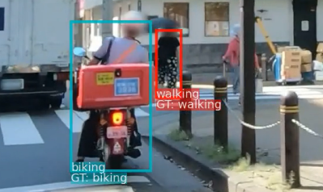
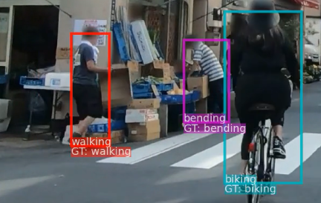
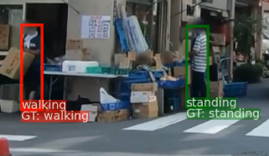
Experiments on Selected Actions
F1 score on the selected actions
Method | walking | standing | sitting | bending | biking | Overall
Poseact (Multitask) | 0.884 | 0.214 | 0.311 | 0.457 | 0.541 | 0.481
ResNet50 [8] | 0.885 | 0.225 | 0.01 | 0.063 | 0.536 | 0.344
Poseact | 0.919 | 0.553 | 0.771 | 0.621 | 0.839 | 0.741
TempPoseact | 0.927 | 0.672 | 0.710 | 0.482 | 0.771 | 0.712
trained on all 5 action groups
tested on selected actions
trained on selected actions,
not multitask
Recognition examples from Poseact
[8] He et al., Deep Residual Learning for Image Recognition. CVPR 2016
Notes:
here are the results after selecting the actions.
The multitask poseact was trained on the original titan dataset, and tested on these selected actions.
probably it has been overwhelmed by “none of the above”, and thus has bad performance
When we train the models on selected actions, we find the temporal model can better classify walking and standing, while the single frame model is better for sitting, bending and biking.
Here are a few recognition examples from the single frame model, and we can see the model works ok for these actions

Slide 12
Effect of Preprocessing and Temporal Module
Using Relative Keypoint Coordinates
17 Absolute coordinates => 1 center location + 17 relative coordinates
Center Point
Possible reason: multiple persons in an image, but their actions are not related with their absolute locations, only the body poses matter
F1 score for each class
Relative coordinates >> absolute coordinates; center point is not very important
When using temporal models, we need object track ID to connect new poses to previous ones
Method | Walking | Standing | Sitting | Bending | Biking | Average
Poseact | 0.919 | 0.553 | 0.771 | 0.621 | 0.839 | 0.741
Abs. Coord | 0.887 | 0.263 | 0.685 | 0.478 | 0.582 | 0.579
Rm. Center | 0.921 | 0.577 | 0.742 | 0.598 | 0.827 | 0.733
TempPoseact (GT) | 0.927 | 0.672 | 0.710 | 0.482 | 0.771 | 0.712
TempPoseact (PifPaf) | 0.923 | 0.653 | 0.575 | 0.467 | 0.761 | 0.676
use absolute coordinates
remove center point
groundtruth object track ID
PifPaf object track ID
Notes:
For TITAN dataset, it’s effective to use relative keypoint coordinates, instead of absolute coordinates.
Pifpaf gives 17 keypoints for a person, and we transform them into one center point plus 17 relative coordinates
A reason is that there are multiple persons in an image, but their actions are not related with their locations.
if we use absolute coordinates, the average F1 will degrade significantly but the center point doesn’t matter that much
Besides, when using temporal models, we need object track IDs to connect new poses to previous ones, and using the groundtruth track ID generally works better than pifpaf track ID

Slide 13
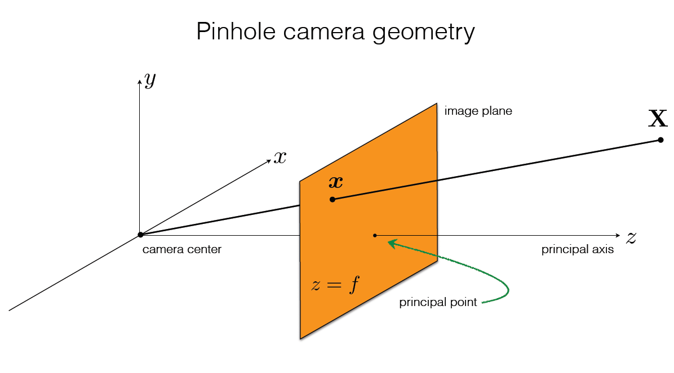
Explorative Experiments
Project 3D poses in TCG onto the image plane of a “virtual camera” (acc 20% lower)
Possible reason: difficult to choose a proper camera pose to keep the actor in FOV
Picture from CMU 16-385 Computer Vision (Kris Kitani) Lecture 11.1 Camera Matrix
Notes:
After these studies, I conducted a few explorative experiments
in TCG, I tired to project the 3D poses onto the image plane of a virtual camera, the accuracy becomes 20% lower than before.
Because it could be difficult to choose a proper camera pose

Slide 14
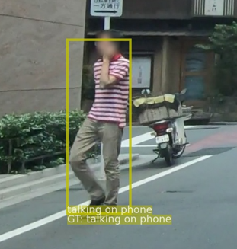
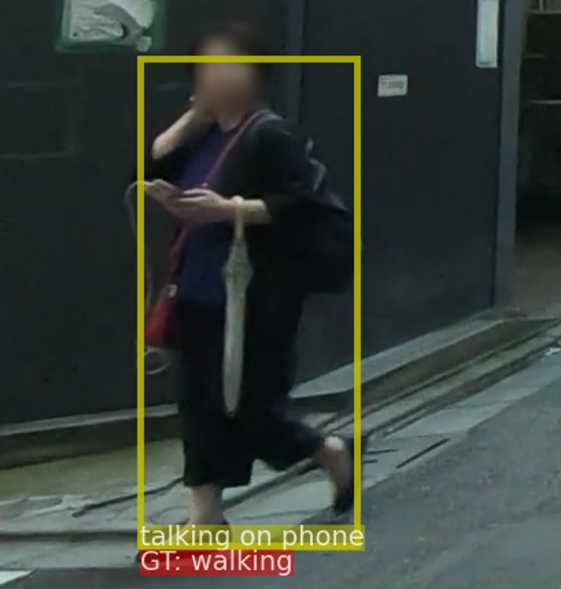
Explorative Experiments
Project 3D poses in TCG onto the image plane of a “virtual camera” (acc 20% lower)
Possible reason: difficult to choose a proper camera pose to keep the actor in FOV
In TITAN, add phone related actions to selected action set (only ~25% F1)
Possible reason: these actions are context-dependent, body poses may not be sufficient
Notes:
In TITAN, I tried to add phone related actions to the selected action set, but we only have 25% F1 score
because they are highly context-dependent, for example this gentleman is talking on the phone, but this lady who has a similar pose is not talking on the phone, however we can’t know this with poses alone

Slide 15
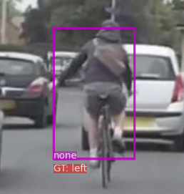
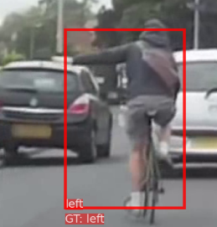
Explorative Experiments
Project 3D poses in TCG onto the image plane of a “virtual camera” (acc 20% lower)
Possible reason: difficult to choose a proper camera pose to keep the actor in FOV
In TITAN, add phone related actions to selected action set (only ~25% F1)
Possible reason: these actions are context-dependent, body poses may not be sufficient
Apply the models to CASR dataset
Good performance on test set, but not on test videos from youtube
Possible reason: the dataset is collected seriously (standard arm signal), but people are more casual in real-life (out-of-distribution problem)
Method | Testset |  | Youtube Set
 | Acc | F1 | Acc | F1
Poseact | 0.93 | 0.91 | 0.68 | 0.47
TempPoseact | 0.92 | 0.89 | 0.66 | 0.46
Heuristics [9] | 0.72 | 0.50 | 0.79 | 0.75
Random Forest [6] | 0.93 | 0.92 | 0.82 | 0.76
[6] Fang et al., Intention Recognition of Pedestrians and Cyclists by 2D Pose Estimation. arXiv:1910.03858
[9] https://github.com/charlesbvll/monoloco
Notes:
As for the CASR dataset, our models have good performance on testset, but no on youtube videos
The reason is that, when making the dataset, the actors use standard arm signal, like this image, but in real life, people are quite casual. So this is probably an out-of-distribution problem.

Slide 16
Discussions
Project Summary
Learned the recent progress of action recognition
Created an evaluation code base for TCG, TITAN and CASR
Experimented basic feed-forward model and temporal model for pose-based action recognition
Explored preprocessing techniques and generalization applications
Key Takeaways
A basic feed forward model can recognize non-context-dependent actions from poses
When multiple persons exist in a frame, it’s better to use relative keypoint coordinates
Take care of the out-of-distribution problem when transferring to different datasets
Future Work
Advanced models (graph-based, attention mechanism), additional features (speed, angular speed)
Methods to promote out-of-distribution performance
Github:https://github.com/Weijiang-Xiong/Action_Recognition
Notes:
In summary, this project has been an excellent journey to me.
I learned about action recognition, created my own code base, conducted experiments and finally explored some ideas.
My key findings are these.
First, a basic feed forward network works ok
second, we can use relative keypoint coordinates
finally, we need to take care of the out-of-distribution problem
In the future, we can try more advanced models or more features, and it would also be interesting to investigate the out-of-distribution performance.
That’s all about my project, thanks for listening.

Slide 17
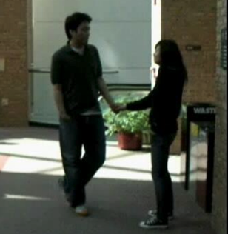


$$× N$$
Image
Linear Layer
Dropout
Linear Layer
Dropout
Embedded Features
Linear
Preprocessing
FC
BN
RelU
Prediction
Head
Variants of Prediction head
x3
Temporal
Multitask
FC 1
Fully
connected
Dropout 0.2
Fully connected
Dropout 0.2
Fully connected
Dropout 0.2
FC
LSTM
FC
Relative
coordinates
x128
x128
x128
Pose Detectoor
Predicted
Actions
$$⋯$$
+
FC 5

